Slide 1
WebRTC 를 이용한 양방향 화상 통신 프론트앤드 개발 및 시그널서버개발 - #4
2018.01
백지훈
jhbaik@moberan.com
이 문서는 나눔글꼴로 작성되었습니다. 설치하기

Slide 2
강의소개
1.1 강의소개
2 / 14
4일차 :
기능 추가
https://github.com/webrtc/samples
CSS 필터
select resolution
화상선택
마이크선택
스피커선택
화상끄기
마이크끄기
음소거
얼굴인식
레코딩
화면공유
영상파일스트리밍

Slide 3
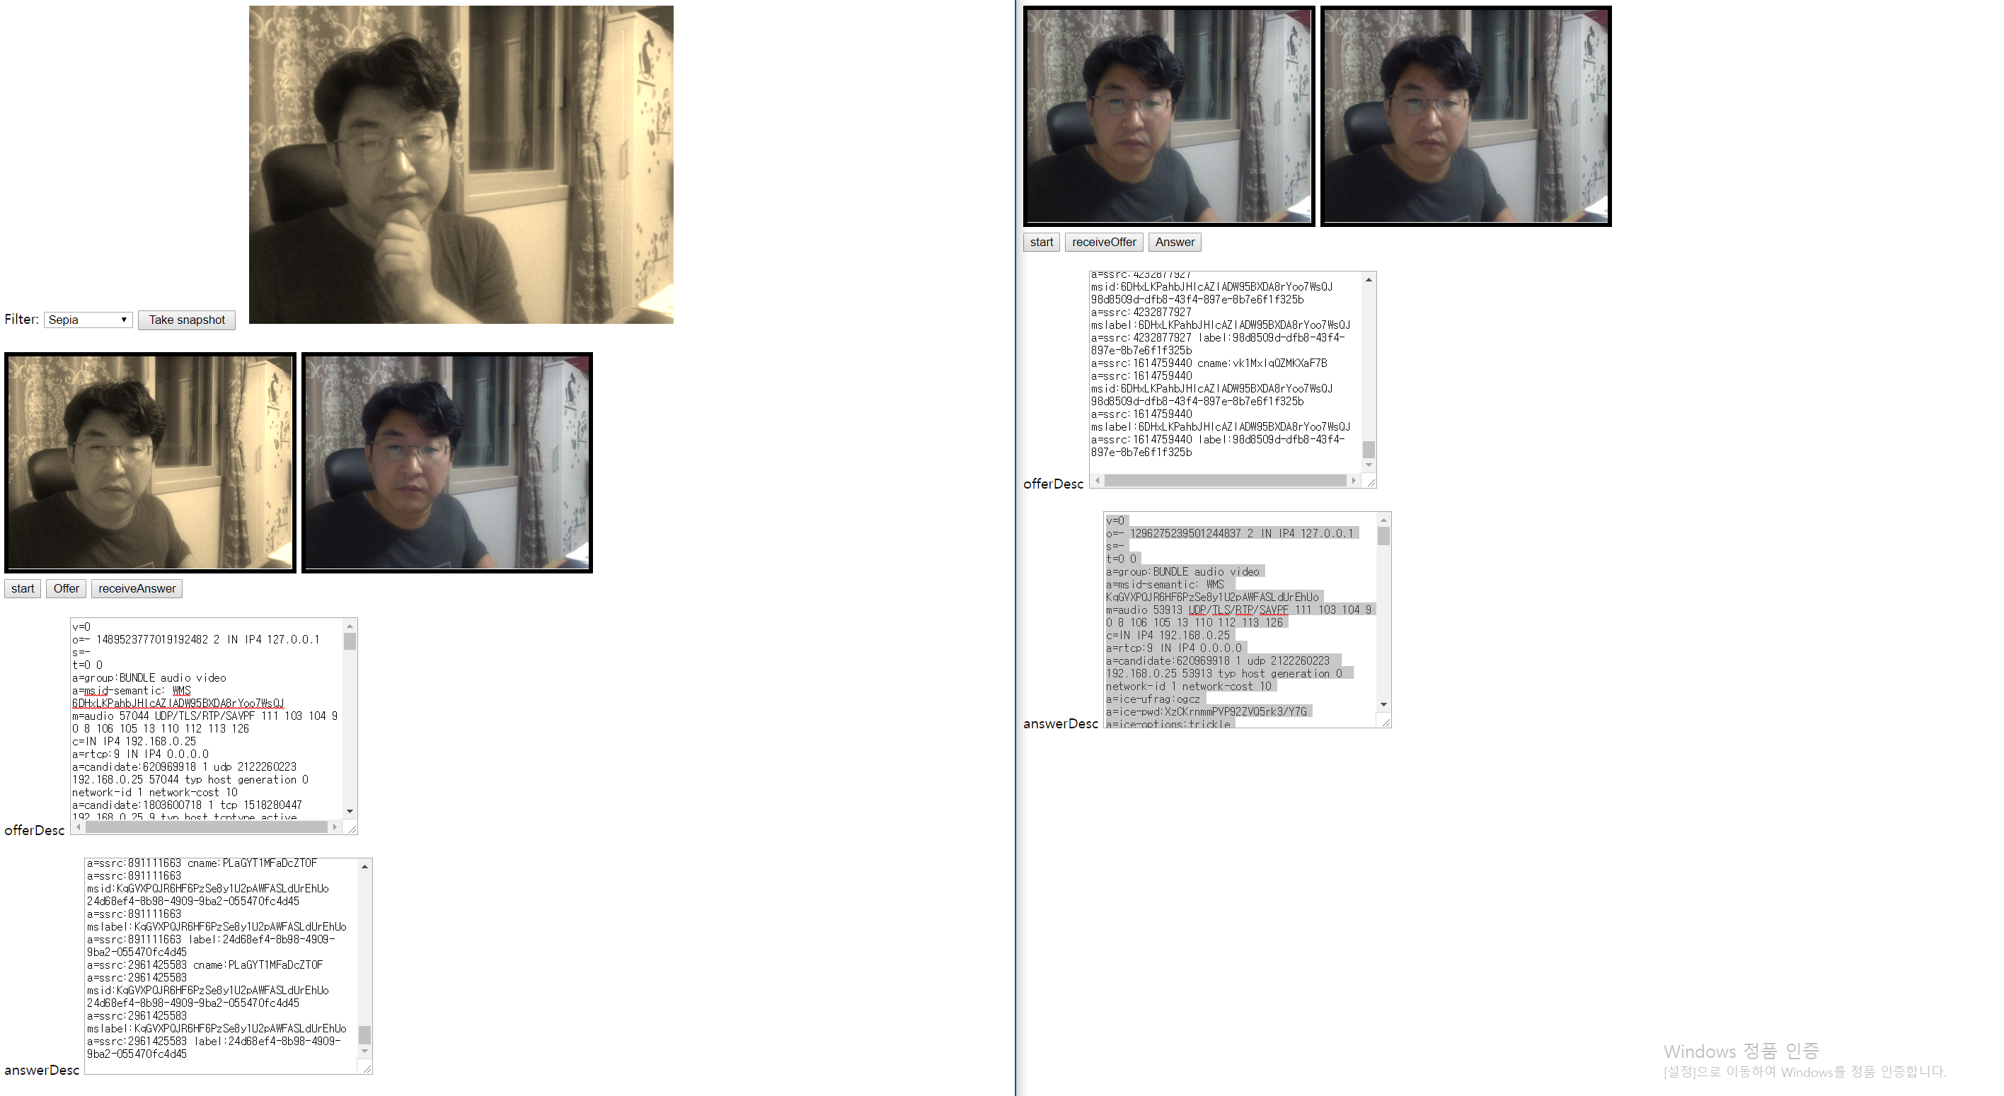
CSS 필터
CSS 필터
3 / 14
http://html5-demos.appspot.com/static/css/filters/index.html https://webrtc.github.io/samples/src/content/getusermedia/filter/

Slide 4
CSS 필터
4 / 14
<style>
.none {
-webkit-filter: none;
filter: none;
}
.blur {
-webkit-filter: blur(3px);
filter: blur(3px);
}
.grayscale {
-webkit-filter: grayscale(1);
filter: grayscale(1);
}
.invert {
-webkit-filter: invert(1);
filter: invert(1);
}
.sepia {
-webkit-filter: sepia(1);
filter: sepia(1);
}
.brightness {
-webkit-filter: brightness(0.4);
filter: brightness(0.4);
}
.contrast {
-webkit-filter: contrast(200%);
filter: contrast(200%);
}
.drop-shadow {
-webkit-filter: drop-shadow(16px 16px 20px blue);
filter: drop-shadow(16px 16px 20px blue);
}
.hue-rotate {
-webkit-filter: hue-rotate(90deg);
filter: hue-rotate(90deg);
}
.opacity {
-webkit-filter: opacity(25%);
filter: opacity(25%);
}
.saturate {
-webkit-filter: saturate(30%);
filter: saturate(30%);
}
.multi {
-webkit-filter: contrast(175%) brightness(3%);
filter: contrast(175%) brightness(3%);
}
button#snapshot {
margin: 0 10px 25px 0;
width: 110px;
}
video {
object-fit: cover;
}
</style>

Slide 5
<label for="select">Filter: </label>
<select id="filter">
<option value="none">None</option>
<option value="blur">Blur</option>
<option value="grayscale">Grayscale</option>
<option value="invert">Invert</option>
<option value="sepia">Sepia</option>
<option value="brightness">brightness</option>
<option value="contrast">contrast</option>
<option value="drop-shadow">drop-shadow</option>
<option value="hue-rotate">hue-rotate</option>
<option value="opacity">opacity</option>
<option value="saturate">saturate</option>
<option value="multi">multi</option>
</select>
<button id="snapshot">Take snapshot</button>
<canvas></canvas>
var snapshotButton = document.querySelector('button#snapshot');
var filterSelect = document.querySelector('select#filter');
var canvas = window.canvas = document.querySelector('canvas');
canvas.width = 480;
canvas.height = 360;
snapshotButton.onclick = function() {
canvas.className = filterSelect.value;
canvas.getContext('2d').drawImage(vid1, 0, 0, canvas.width, canvas.height);
};
filterSelect.onchange = function() {
vid1.className = filterSelect.value;
};

Slide 6
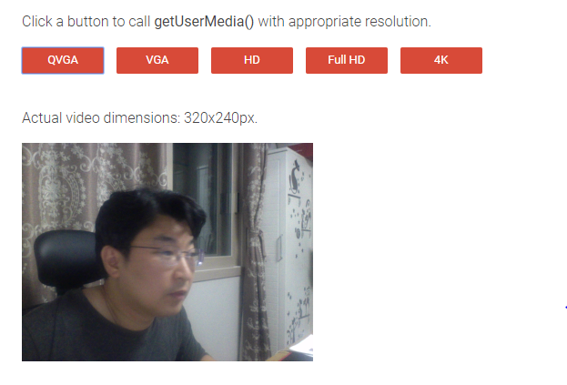
select resolution
select resolution
6 / 14
https://webrtc.github.io/samples/src/content/getusermedia/resolution/

Slide 7
var qvgaConstraints = {
video: {width: {exact: 320}, height: {exact: 240}}
};
var vgaConstraints = {
video: {width: {exact: 640}, height: {exact: 480}}
};
var hdConstraints = {
video: {width: {exact: 1280}, height: {exact: 720}}
};
var fullHdConstraints = {
video: {width: {exact: 1920}, height: {exact: 1080}}
};
var fourKConstraints = {
video: {width: {exact: 4096}, height: {exact: 2160}}
};
function getMedia(constraints) {
if (stream) {
stream.getTracks().forEach(function(track) {
track.stop();
});
}
clearErrorMessage();
videoblock.style.display = 'none';
navigator.mediaDevices.getUserMedia(constraints)
.then(gotStream)
.catch(function(e) {
errorMessage('getUserMedia', e.name);
});
}

Slide 8
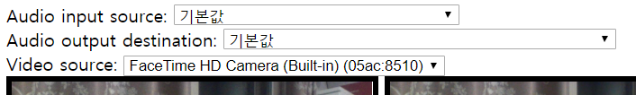
화상선택 / 마이크선택
화상선택 / 마이크선택
8 / 14
Device enumerate and selection
getUserMedia 다시 실행
RTCPeerConnection 재생성 (Offer/Answer)
navigator.mediaDevices.enumerateDevices().then(gotDevices).catch(handleError);
function start() {
if (window.stream) {
window.stream.getTracks().forEach(function(track) {
track.stop();
});
}
var audioSource = audioInputSelect.value;
var videoSource = videoSelect.value;
var constraints = {
audio: {deviceId: audioSource ? {exact: audioSource} : undefined},
video: {deviceId: videoSource ? {exact: videoSource} : undefined}
};
navigator.mediaDevices.getUserMedia(constraints).
then(cbGotStream).then(gotDevices).catch(handleError);
}

Slide 9
스피커선택
스피커선택
9 / 14
Video Element 의 audioDestination 원하는 Device 로 연결
function attachSinkId(element, sinkId) {
if (typeof element.sinkId !== 'undefined') {
element.setSinkId(sinkId)
.then(function() {
console.log('Success, audio output device attached: ' + sinkId);
})
.catch(function(error) {
var errorMessage = error;
if (error.name === 'SecurityError') {
errorMessage = 'You need to use HTTPS for selecting audio output ' +
'device: ' + error;
}
console.error(errorMessage);
// Jump back to first output device in the list as it's the default.
audioOutputSelect.selectedIndex = 0;
});
} else {
console.warn('Browser does not support output device selection.');
}
}
function changeAudioDestination() {
var audioDestination = audioOutputSelect.value;
attachSinkId(vid2, audioDestination);
}

Slide 10
화상끄기
화상끄기
10 / 14
function onToggleVideo() {
if (localstream) {
var items = localstream.getVideoTracks();
if (items && items.length > 0)
items[0].enabled = !items[0].enabled;
}
}

Slide 11
마이크끄기
마이크끄기
11 / 14
function onToggleMic() {
if (localstream) {
var items = localstream.getAudioTracks();
if (items && items.length > 0)
items[0].enabled = !items[0].enabled;
}
}

Slide 12
음소거
음소거
12 / 14
function onToggleSound() {
if (remotestream) {
var items = remotestream.getAudioTracks();
if (items && items.length > 0)
items[0].enabled = !items[0].enabled;
}
}

Slide 13
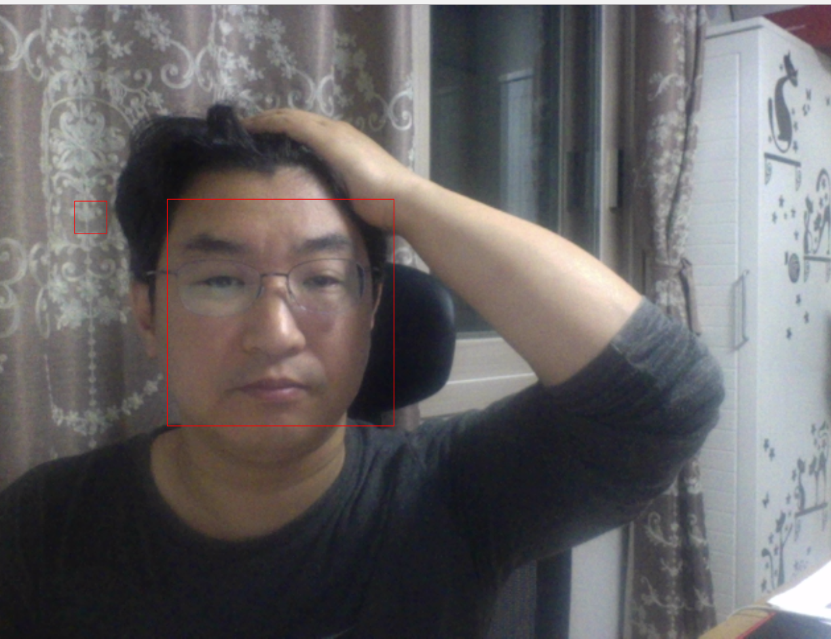
얼굴인식
얼굴인식
13 / 14
https://webrtc.github.io/samples/src/content/getusermedia/face/

Slide 14
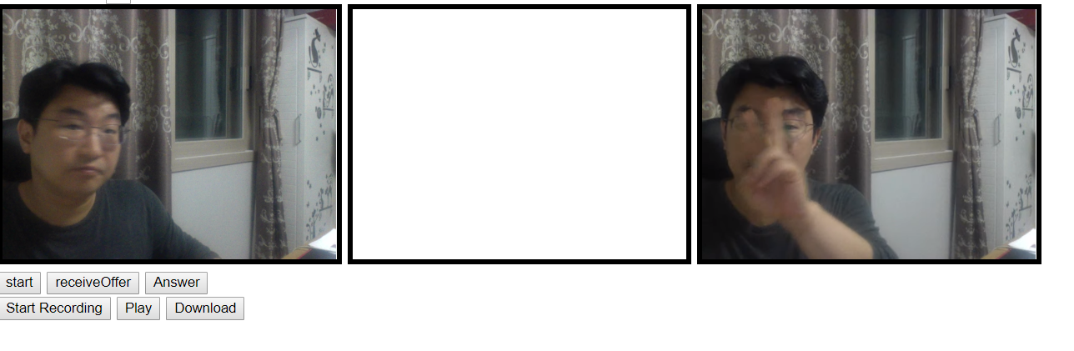
레코딩
레코딩
14 / 14
https://webrtc.github.io/samples/src/content/getusermedia/record/

Slide 15
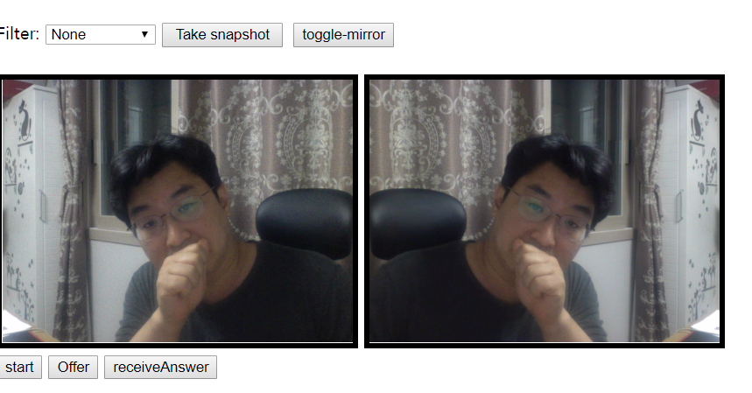
반전
반전
15 / 14

Slide 16
<style>
.mirror {
transform: scale(-1, 1); /*For Firefox (& IE) */
-webkit-transform: scale(-1, 1); /*for Chrome & Opera (& Safari) */
}
</style>
var toggleMirrorButton = document.querySelector('button#toggle-mirror');
var vidClassName = '';
toggleMirrorButton.onclick = function() {
if (!vidClassName)
vidClassName = 'mirror';
else
vidClassName = '';
vid1.className = vidClassName;
};

Slide 17
화면공유
화면공유
17 / 14
https://github.com/nhnent/fe.javascript/wiki/August-8---August-12,-2016

Slide 18
참고
https://github.com/muaz-khan/getScreenId
크롬 익스텐션
https://chrome.google.com/webstore/detail/screen-capturing/ajhifddimkapgcifgcodmmfdlknahffk
<script src="https://cdn.WebRTC-Experiment.com/getScreenId.js"></script>
getScreenId((error, sourceId, screenConstraints) => {
if (error === 'not-installed') return alert('The extension is not installed');
if (error === 'permission-denied') return alert('Permission is denied.');
if (error === 'not-chrome') return alert('Please use chrome.');
navigator.mediaDevices.getUserMedia(screenConstraints)
.then(stream => {
window.stream = stream;
vid1.srcObject = stream;
localstream = stream;
})
.catch(err => {
console.log(err);
});
});
/*
navigator.mediaDevices.getUserMedia({
audio: true,
video: true
})
.then(cbGotStream)
.catch(function (e) {
alert('getUserMedia() error: ' + e);
});
*/

Slide 19
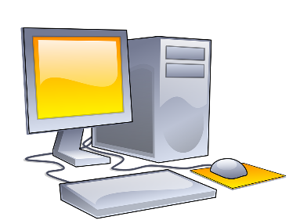
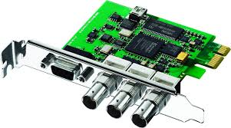
영상파일스트리밍
영상파일스트리밍
19 / 14
영상신호
캡쳐보드
영상재생
캡쳐보드에서 들어오는 영상신호를 WebCAM 으로 인식.

Slide 20
감사합니다
이 문서는 나눔글꼴로 작성되었습니다. 설치하기

